Slide 1
Learning Management Systems, App Stores, Content Repositories, and Analytics
Charles R. Severance
www.dr-chuck.com

Slide 2

Enterprise Learning Management System (LMS) Been there – done that – got the tattoo.. But…

Slide 3

http://planet-fall.deviantart.com/art/The-Monolith-80407794

Slide 4
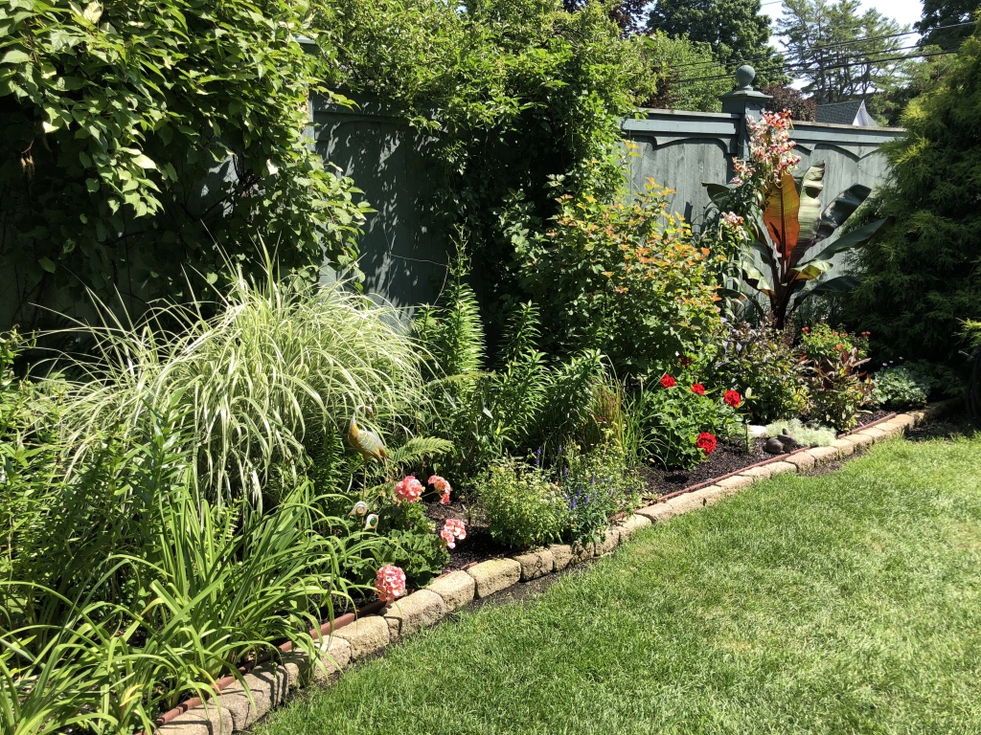



Slide 5









Monolithic LMS Have Dominated the Market
Content Authoring
Content Delivery
Assessment authoring
Assessment delivery
Grade Book
Proprietary plugins
Proprietary Learning Object Repositories

Slide 6
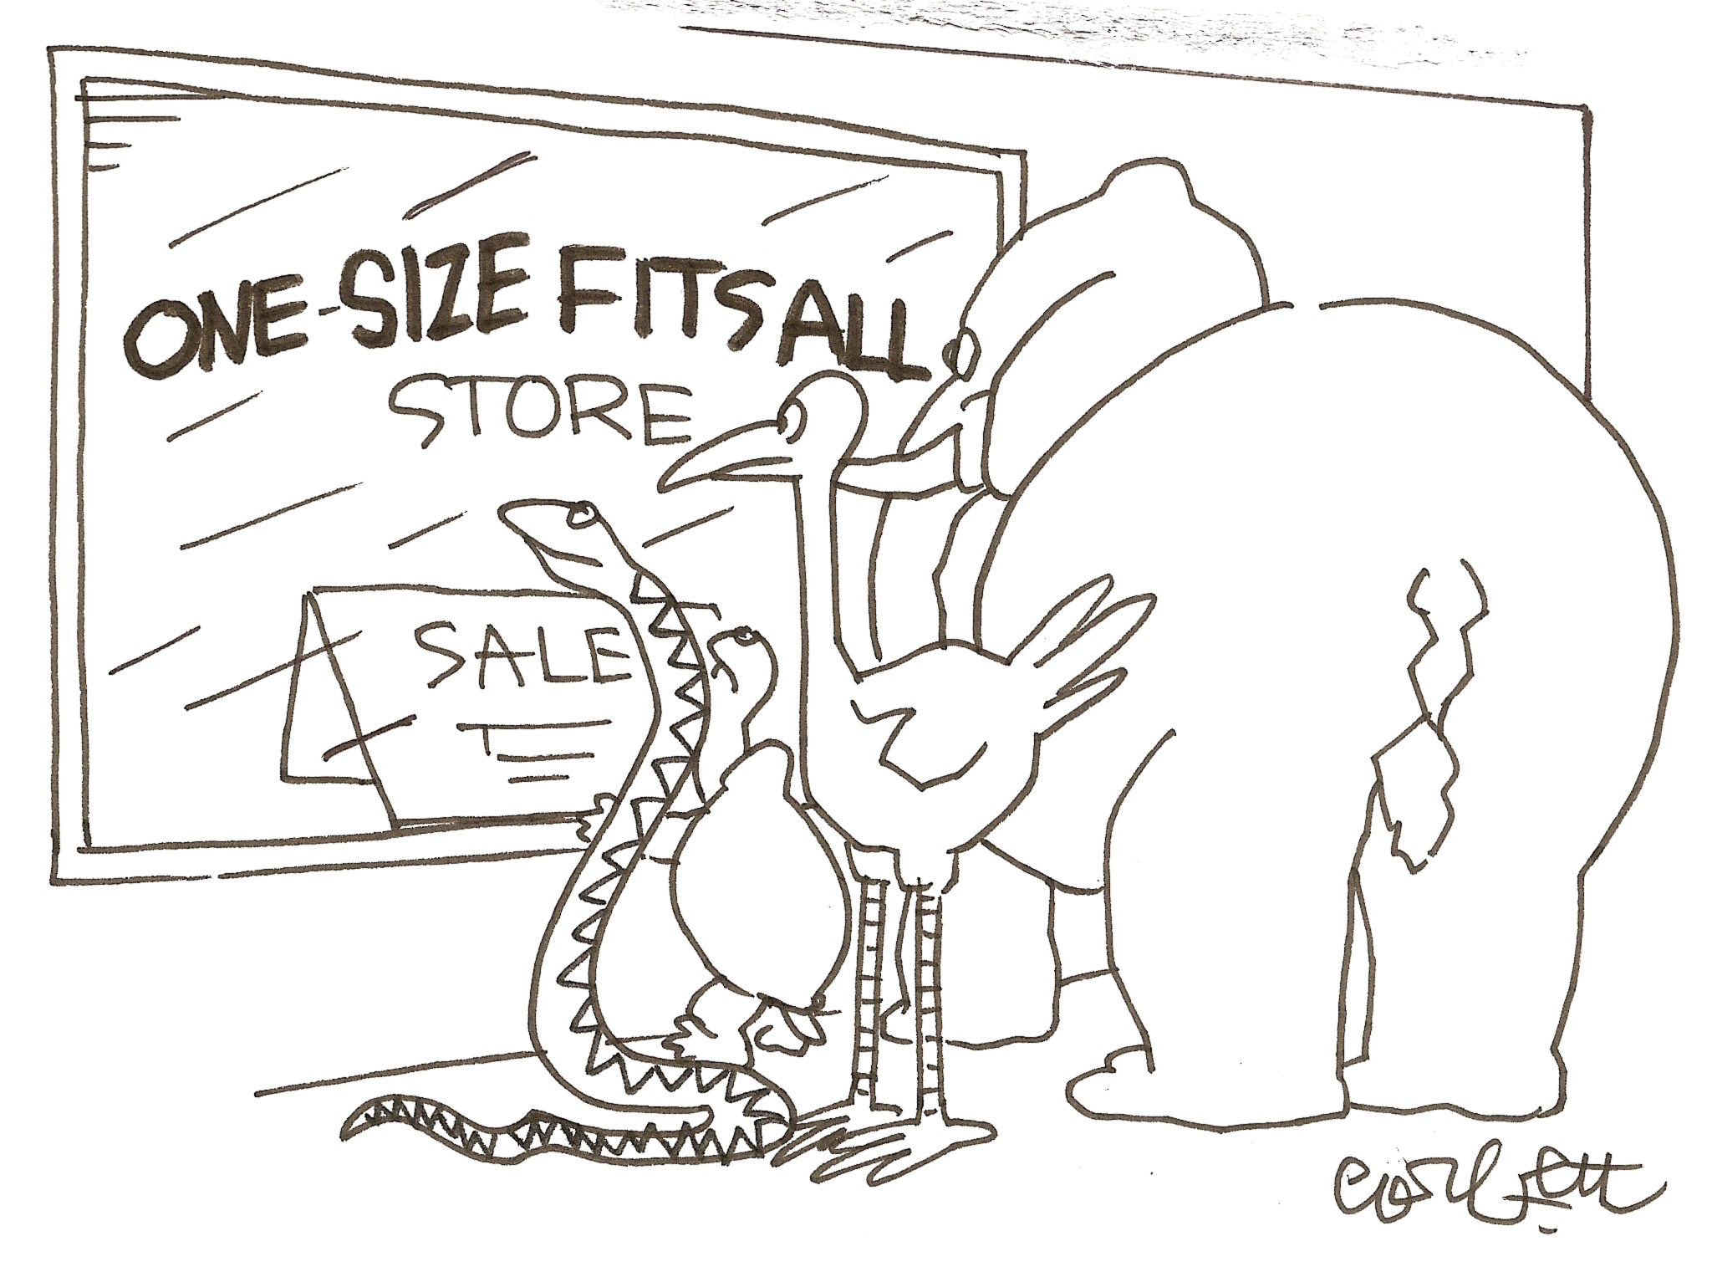

Slide 7
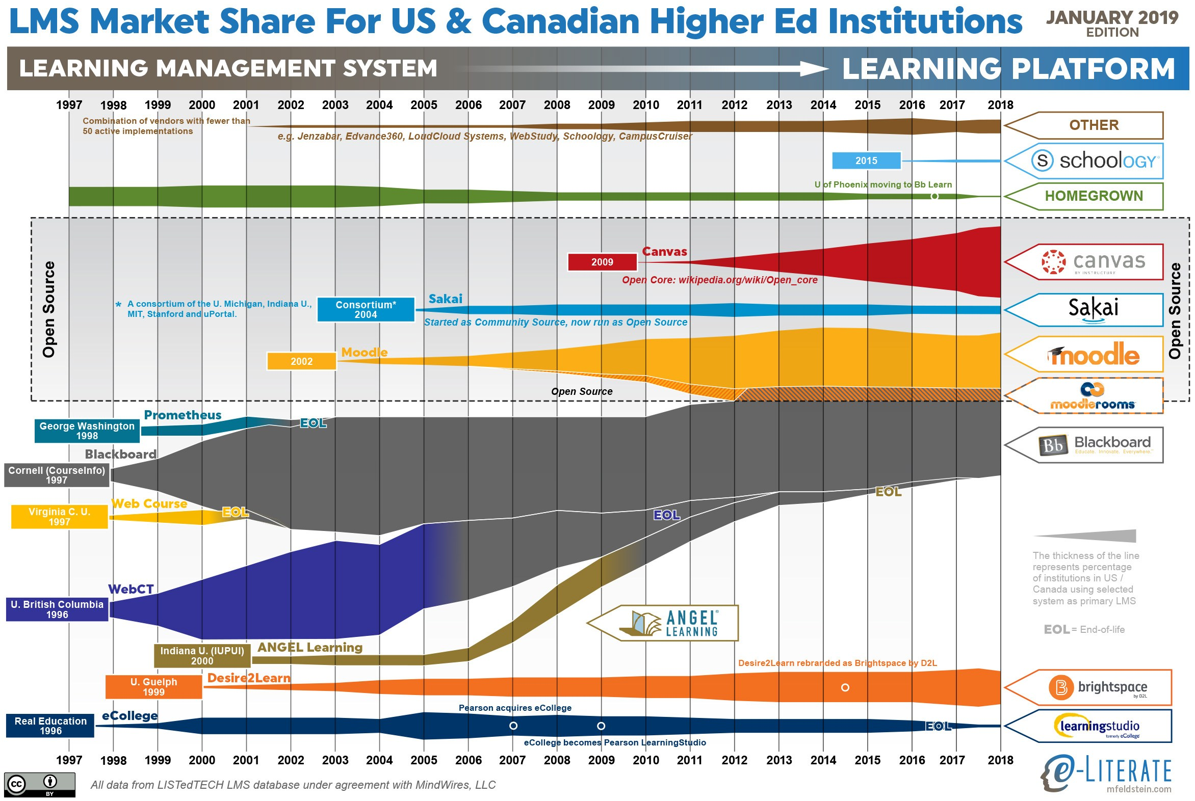

Slide 8
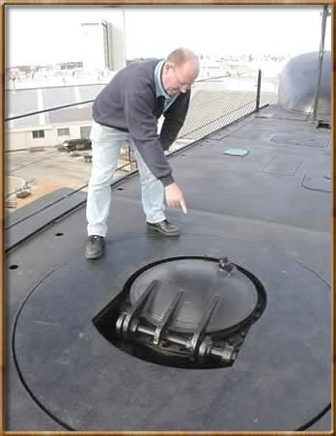

Standards 1.0
Tools Interoperability
Tools Interoperability (TI) 28 Feb 2006
LTI - 17 May 2010
IMS Common Cartridge 1.0
1 October 2008

Slide 9
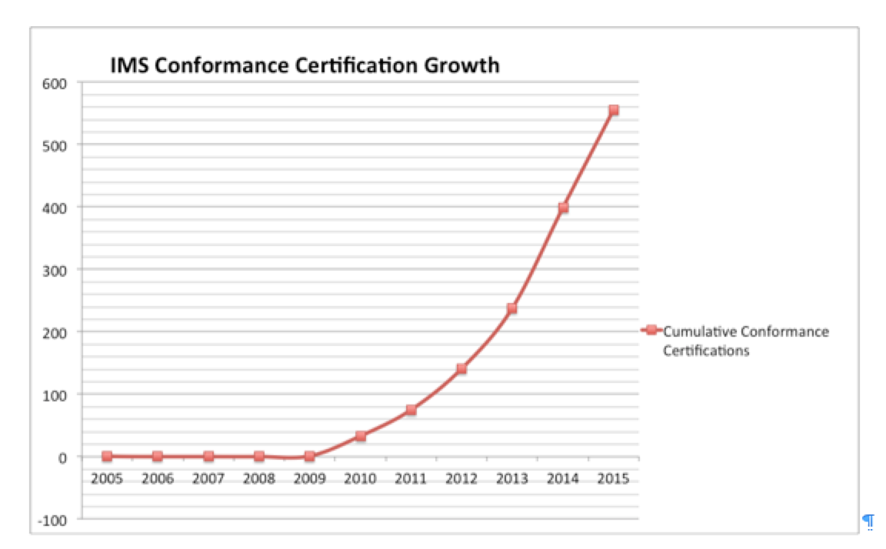
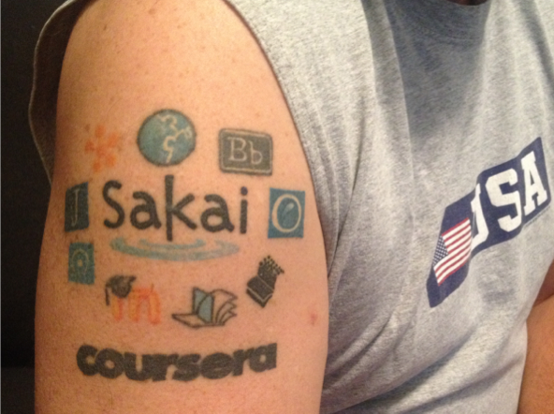

Slide 10


































Slide 11


Ten Years of Standards
IMS Common Cartridge – 1.0, 1.1, 1.2, 1.3
IMS Learning Tools Interoperability 1.0, 1.1
IMS LTI Content Item - 1.0
IMS LTI Membership Services – 1.0
Outcomes Management Service 2.0
IMS Caliper 1.0, 1.1
IMS OneRoster – 1.0

Slide 12
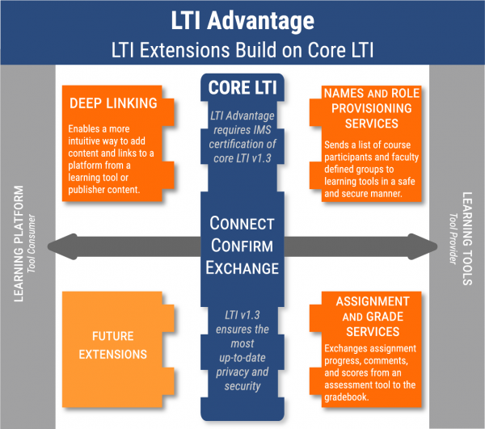


Slide 13
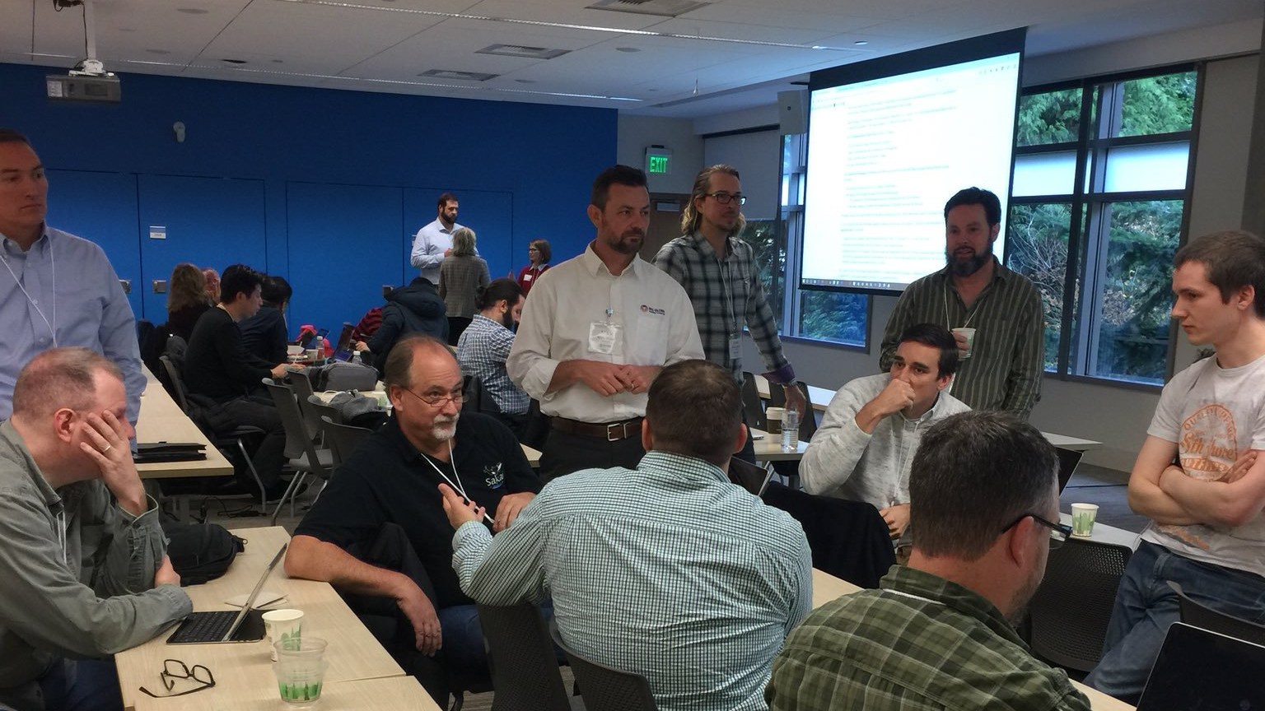

Slide 14
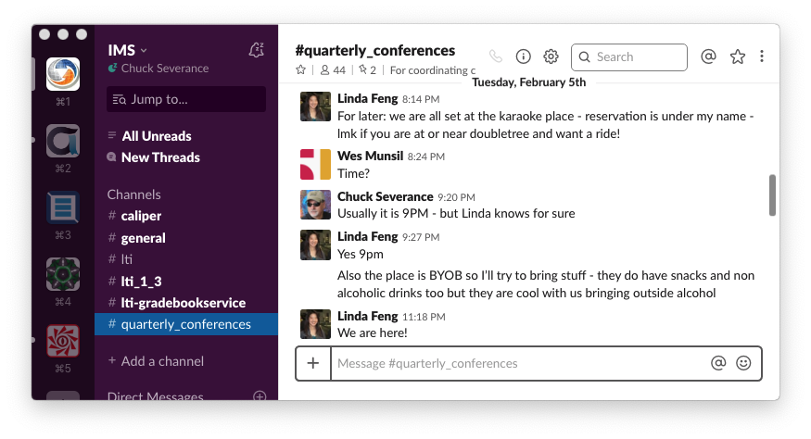

Slide 15
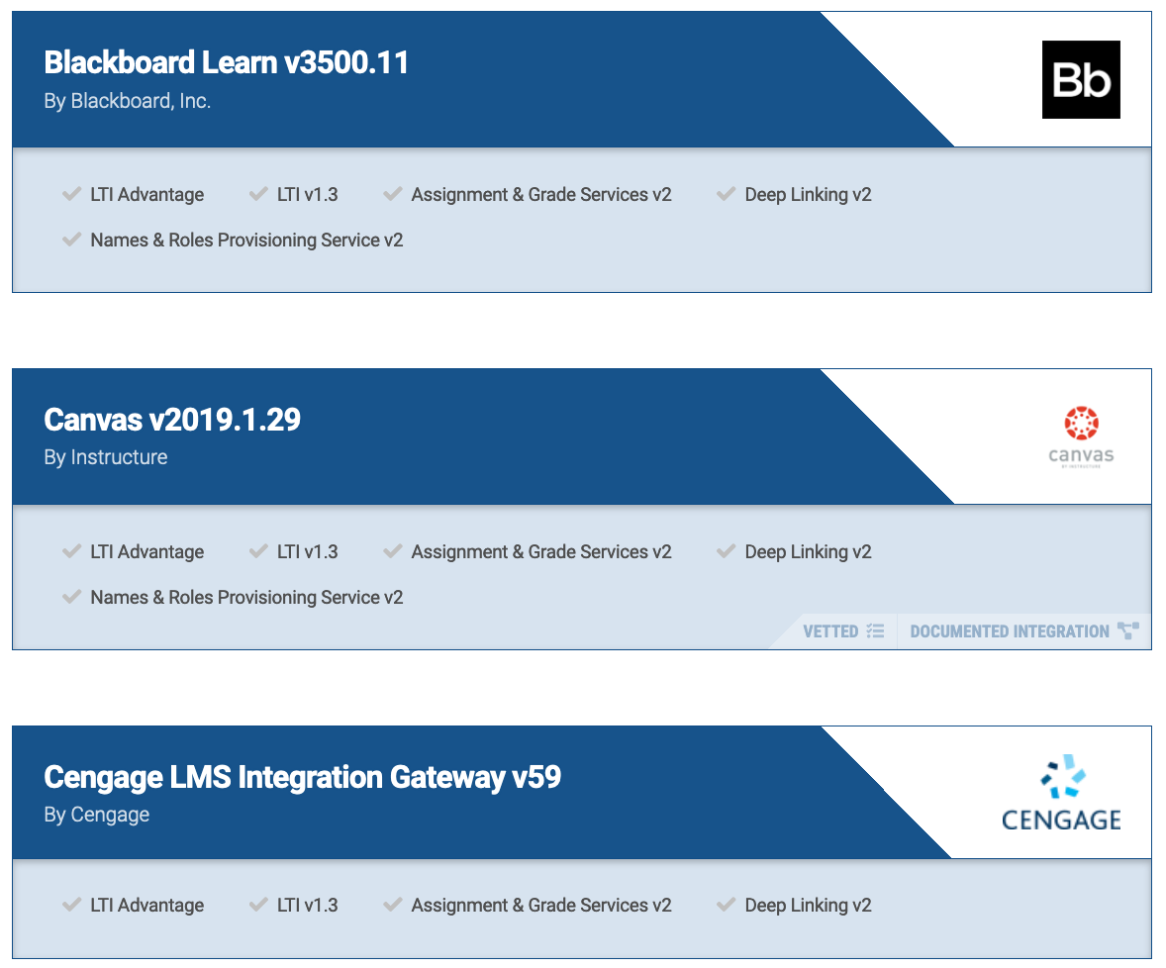
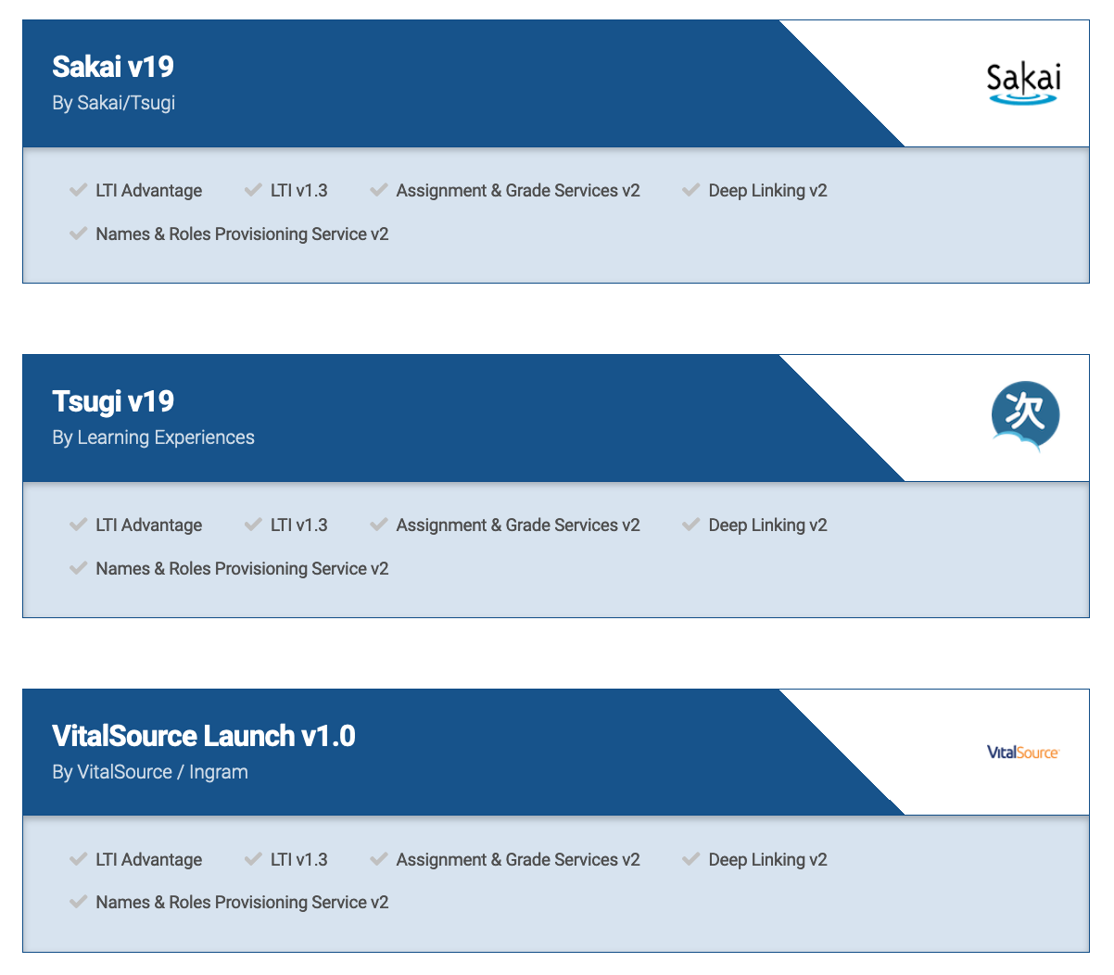
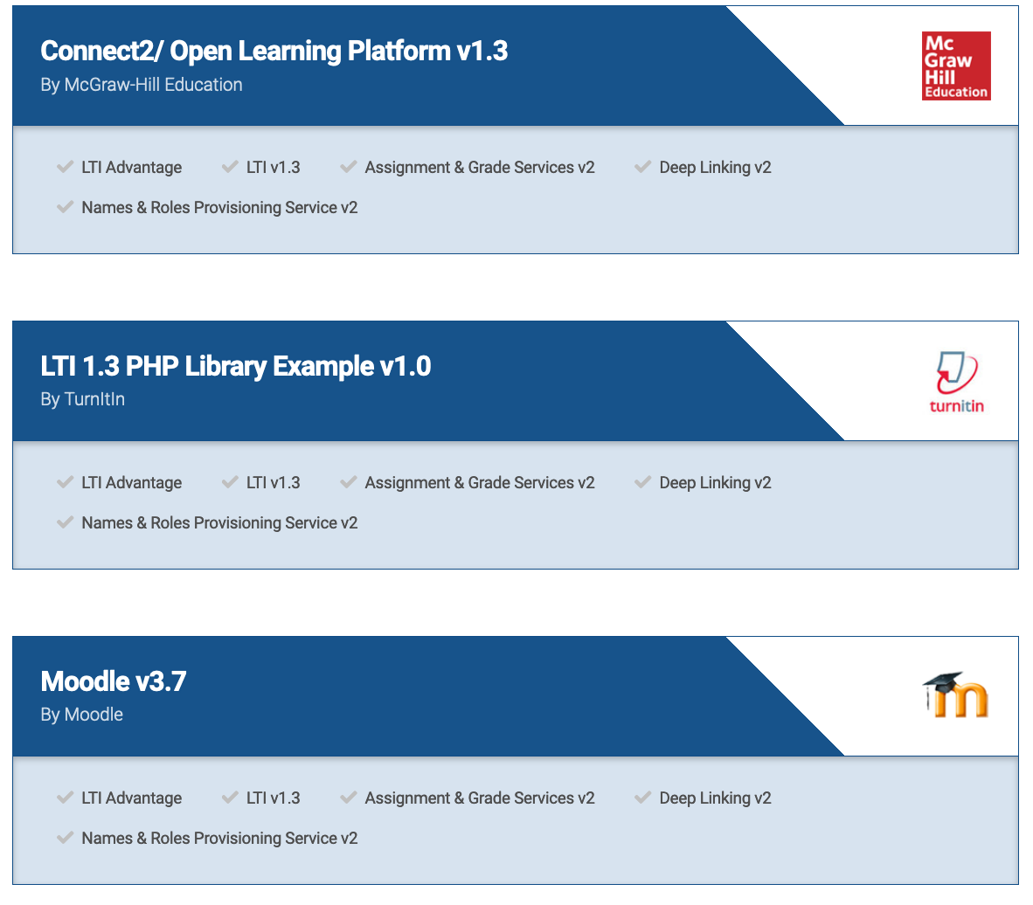

Slide 16
IMS LTI Released
IMS TI Released

Slide 17

Deep
Linking®
CC®
LTI®
FOR THE FIRST TIME IN THE HISTORY OF EDUCATIONAL TECHNOLOGY, YOU CAN MAKE AN APP STORE AND LEARNING OBJECT REPOSITORY WITHOUT PROPRIETATY EXTENSIONS.
LTI®, CC®, and Depp Linking® are trademarks of IMS Global Learning Consortium, Inc. (www.imsglobal.org)

Slide 18
Monolithic LMS Have Dominated the Market
Content Authoring
Content Delivery
Assessment authoring
Assessment delivery
Grade Book
Proprietary plugins
Proprietary Learning Object Repositories

Slide 19
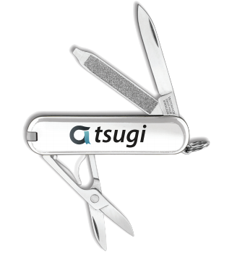
Unbundling the LMS Marketplace
Content Authoring
Content Delivery
Assessment authoring
Assessment delivery
Grade Book
Standard plugins
Standard Learning Object Repositories

Slide 20

Source: Ian Dolphin

Slide 21

The future is already here — it's just not very evenly distributed.
- William Gibson
https://en.wikiquote.org/wiki/William_Gibson

Slide 22


umich.edu
Sakai
Piazza
300
open.umich.edu (drupal)
2
Circa 2012
Notes:
Common Cartridge 2008 / 2011
Learning Tools Interoperability 2011
Content Item 2016

Slide 23
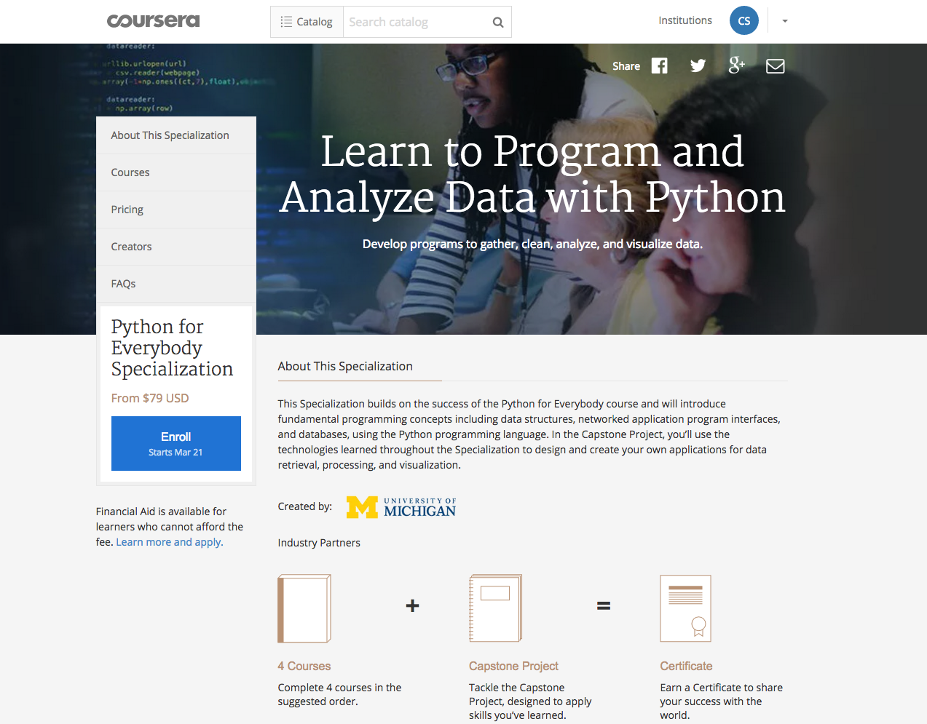

Slide 24
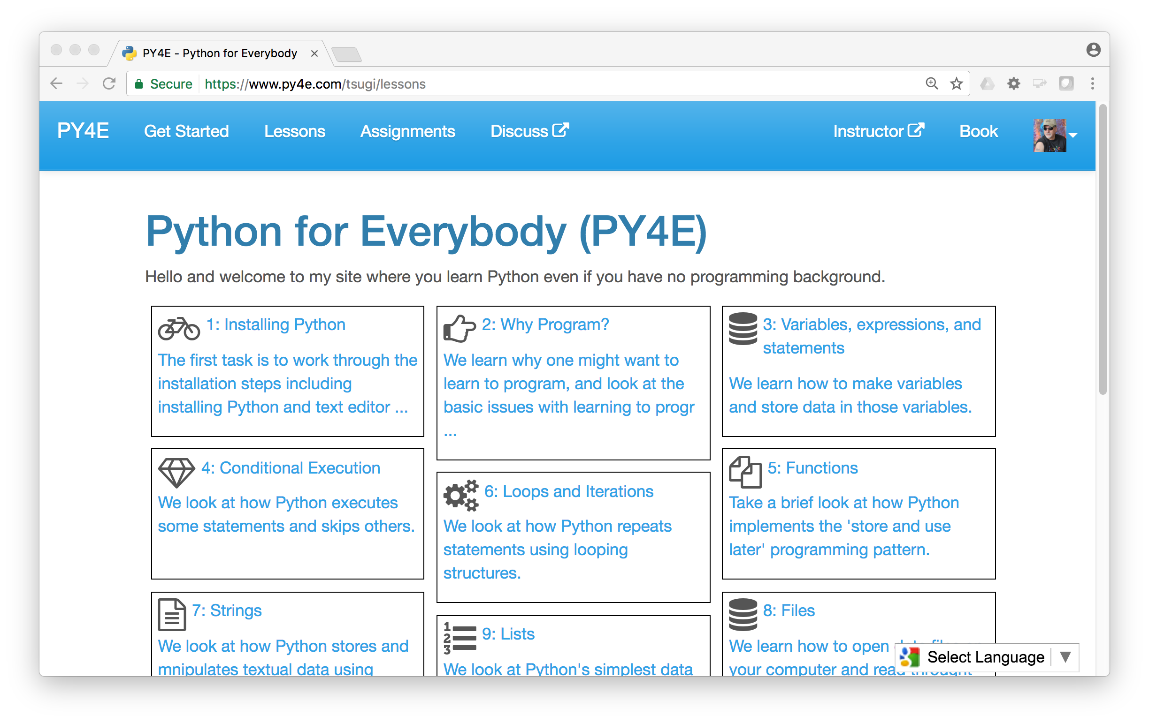
www.py4e.com

Slide 25



KindleDirect
50
Pandoc
py4e.com
App Store (次)
OER Content (코스)
3K
github
4M
Coursera
Media
UM/Canvas
300
archive.org
Amazon
YouTube
ITunes
GooglePlay

Slide 26
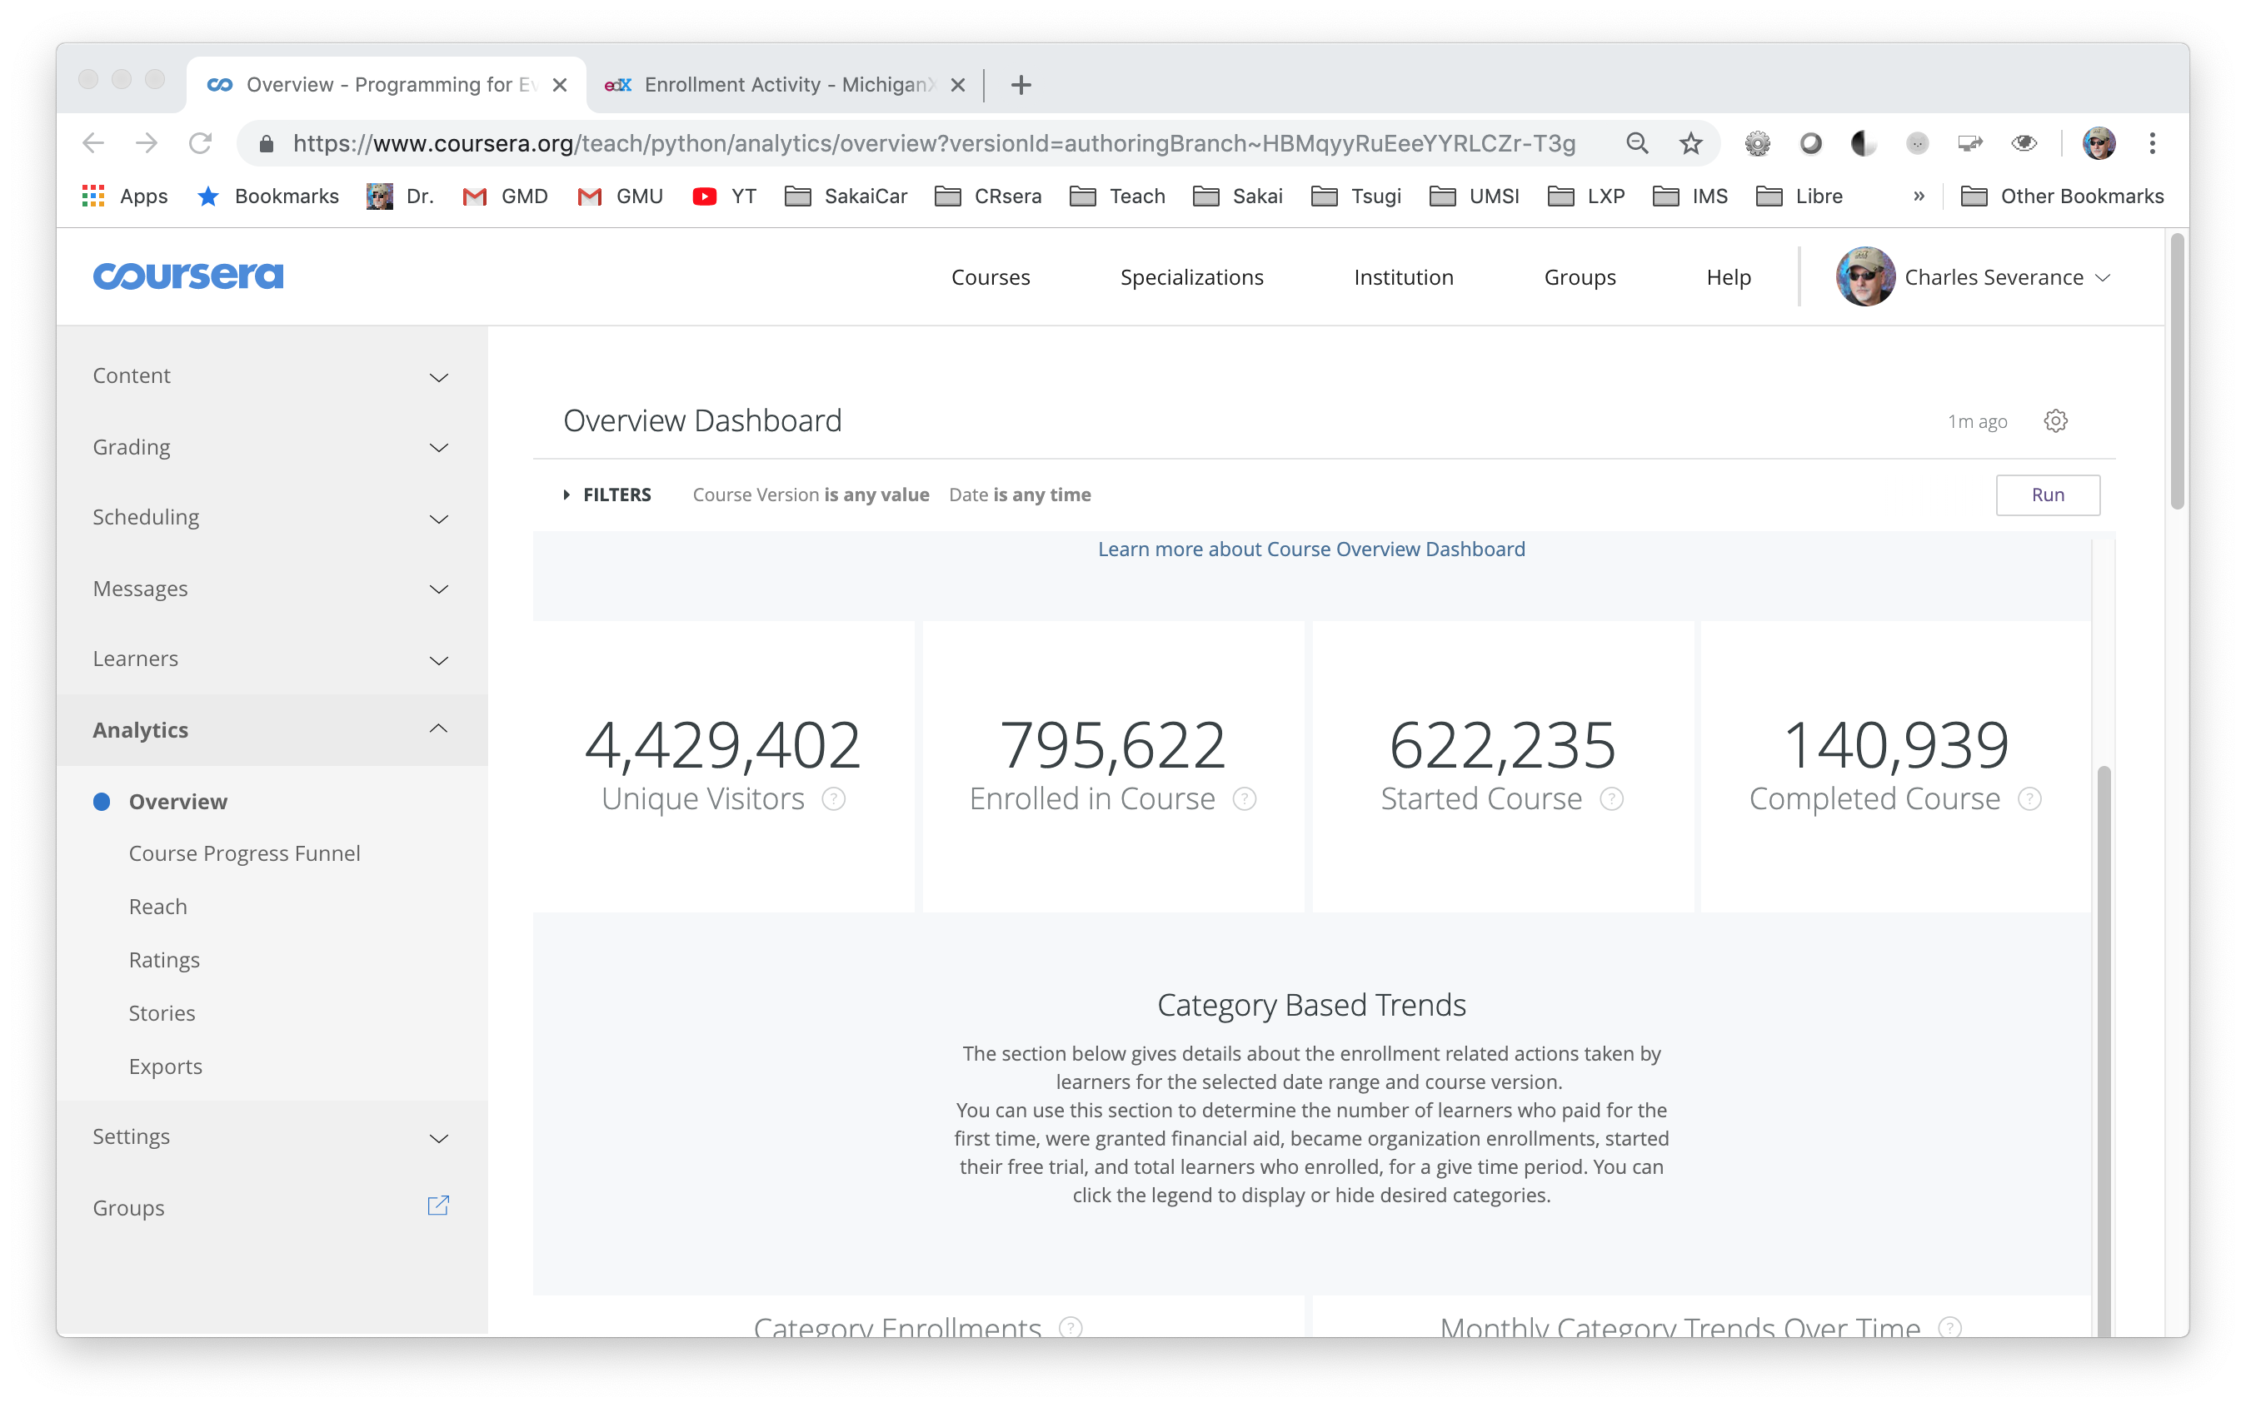

Slide 27
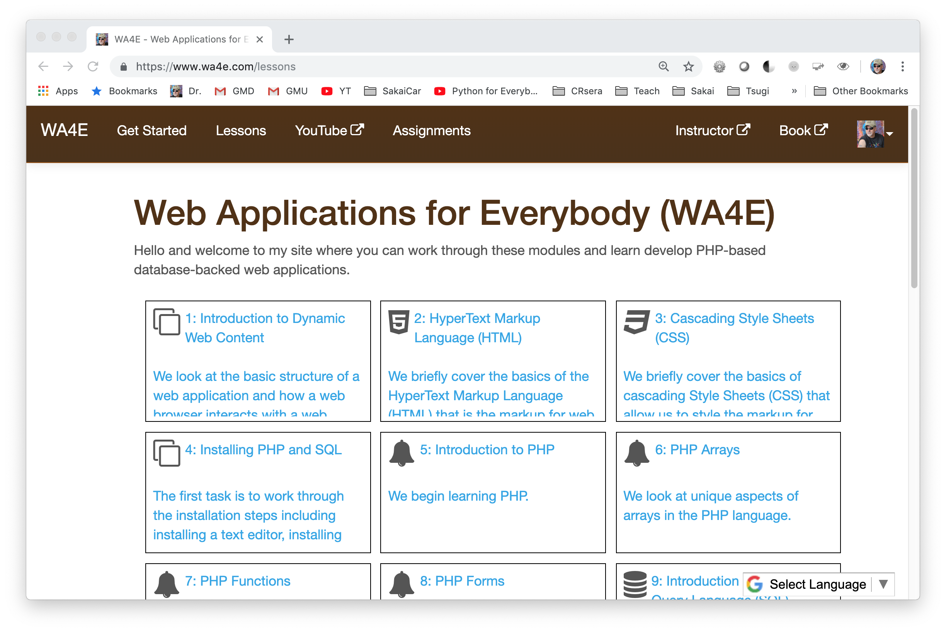

Slide 28
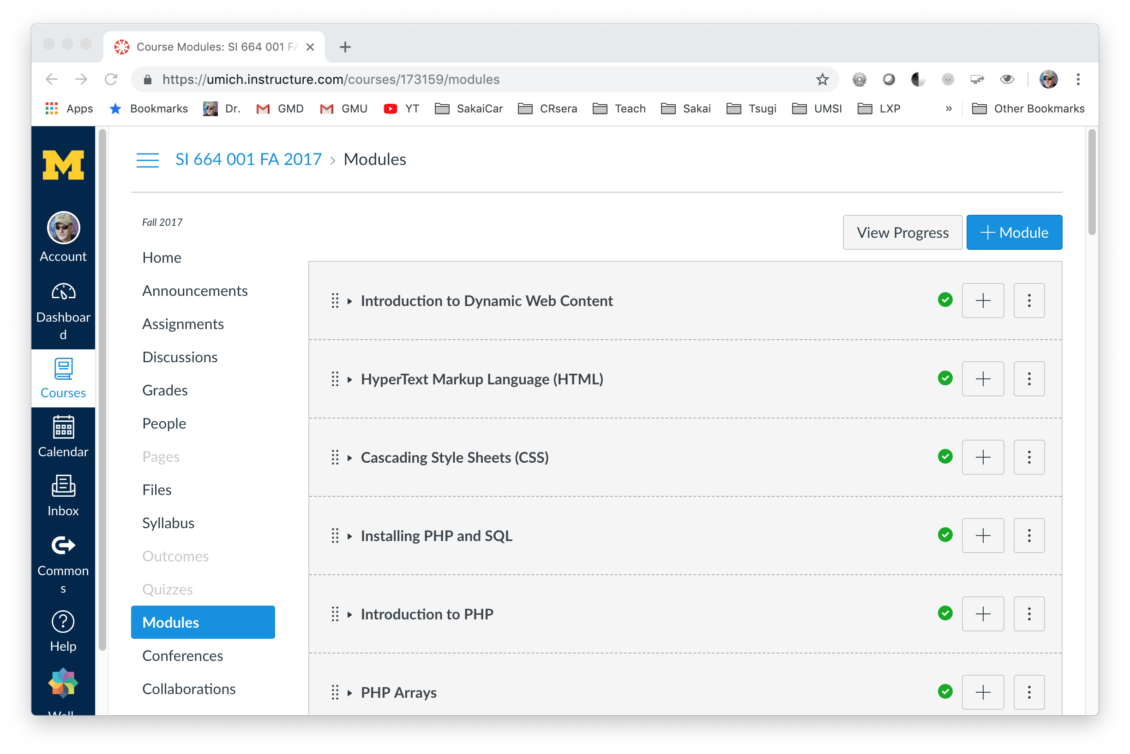

Slide 29
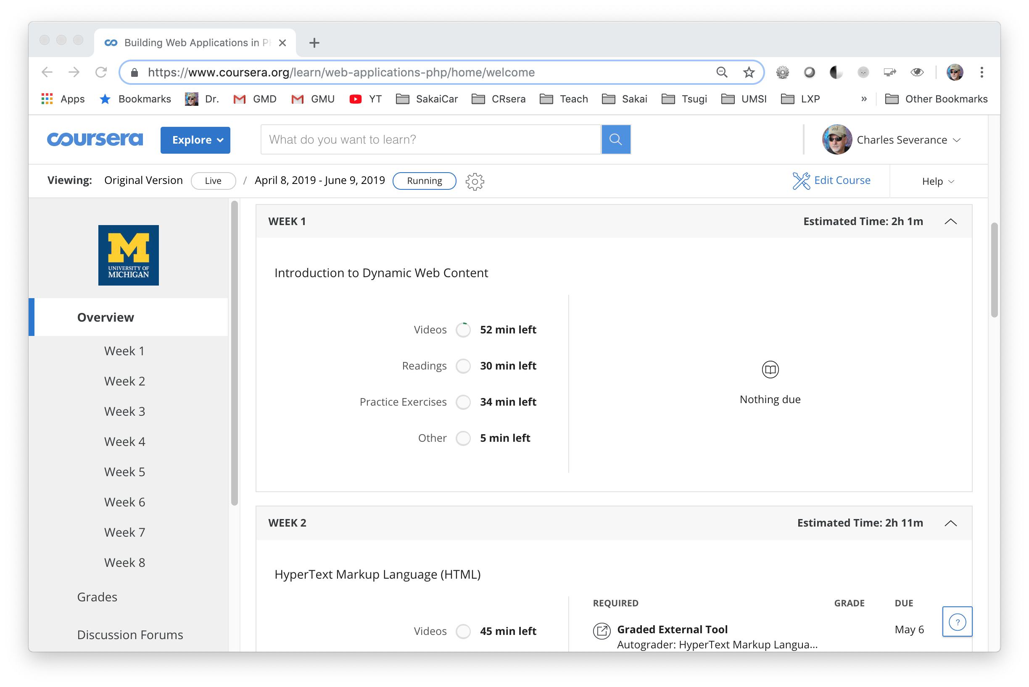

Slide 30
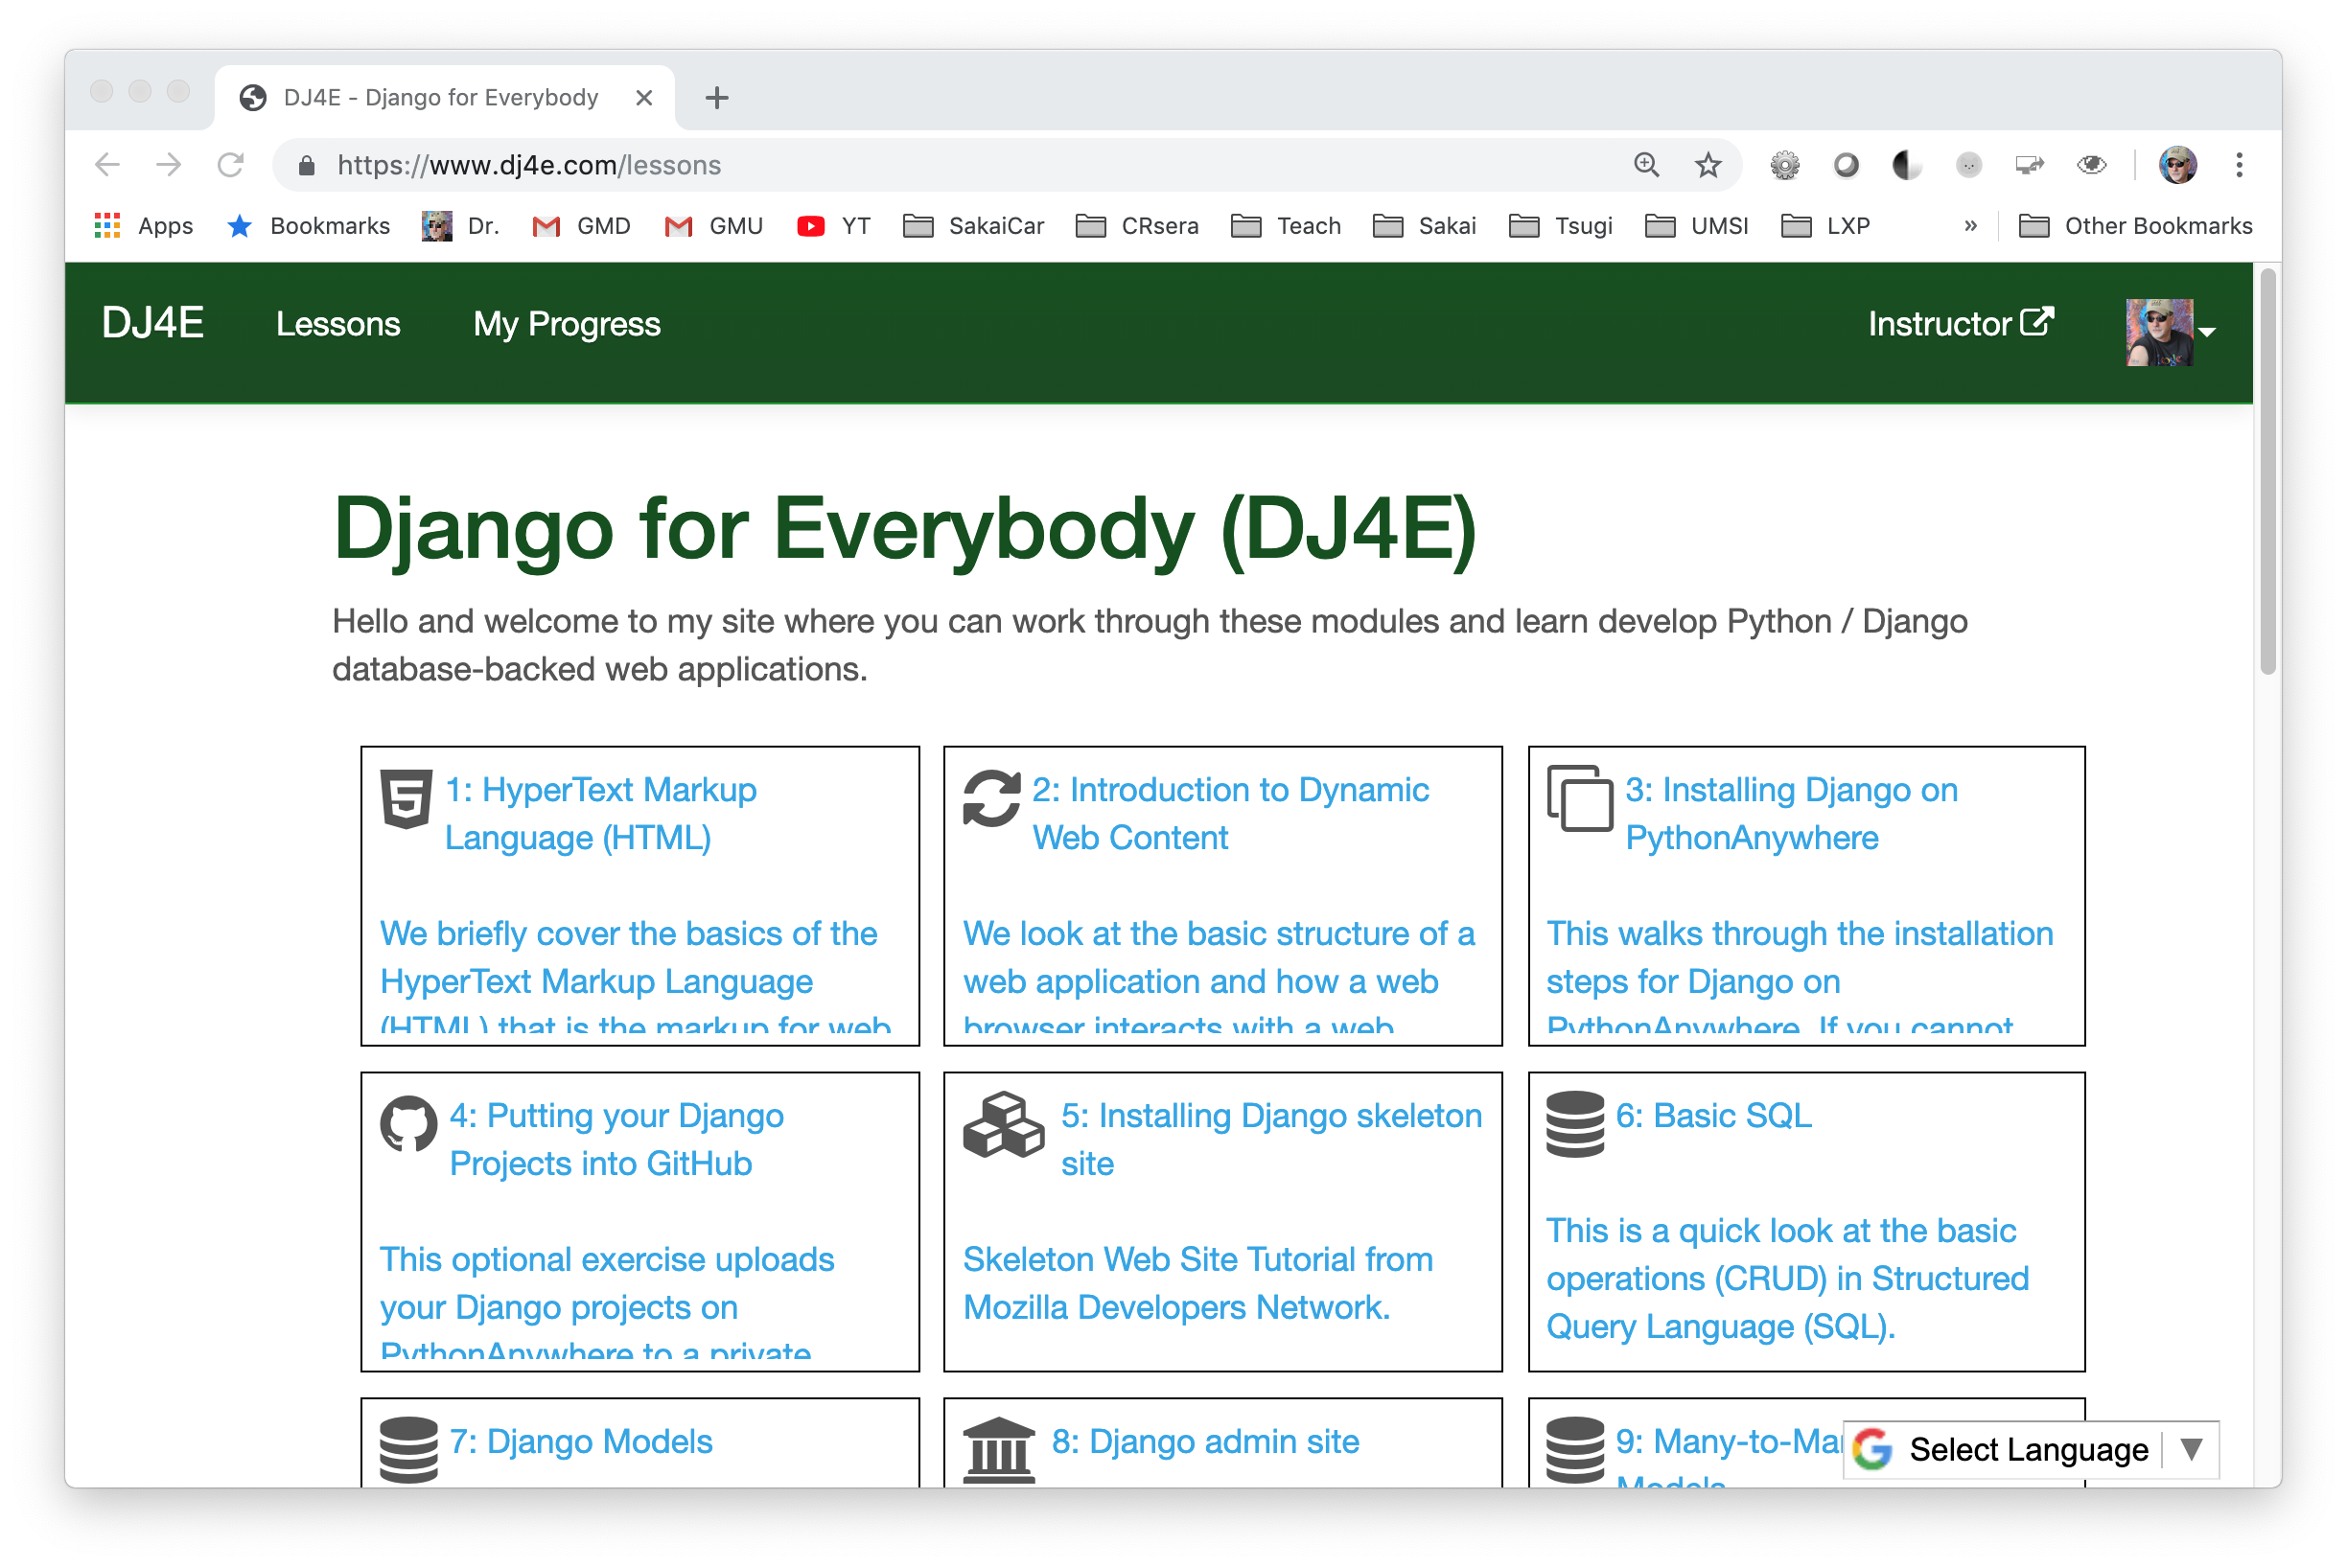

Slide 31
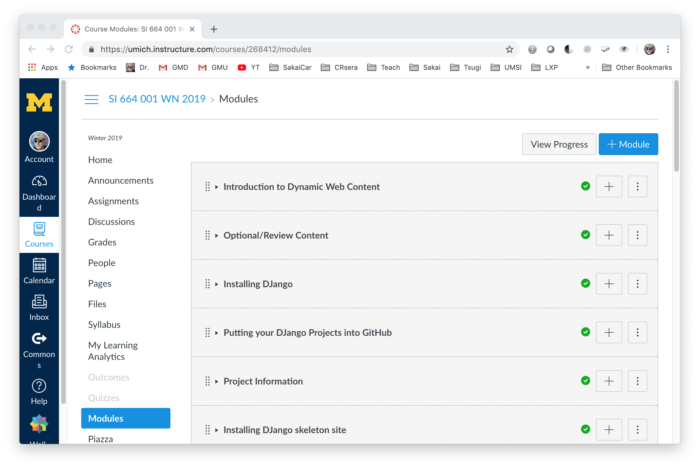

Slide 32

2020 ???

Slide 33
Unbundling the LMS Marketplace
Content Authoring
Content Delivery
Assessment authoring
Assessment delivery
Grade Book
Standard plugins
Standard Learning Object Repositories

Slide 34






IMS LTI® IMS Deep Linking® IMS Common Cartridge®

Slide 35
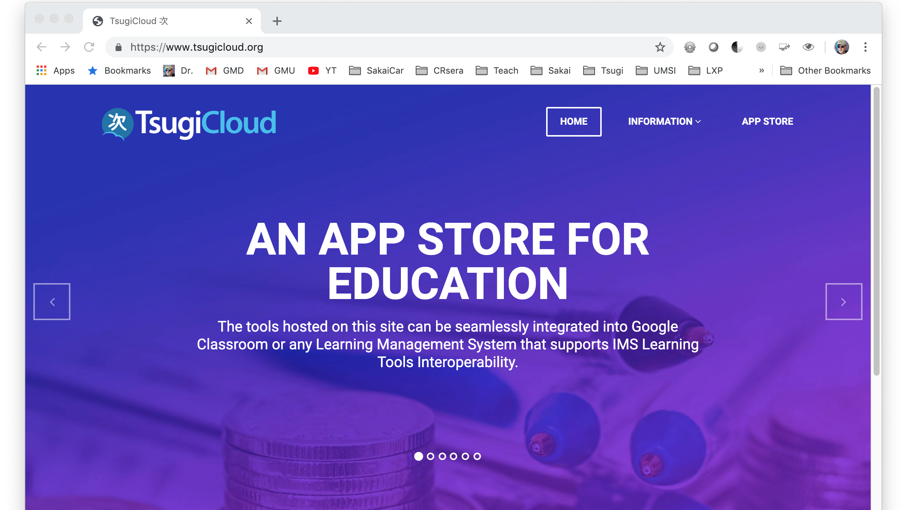

Slide 36
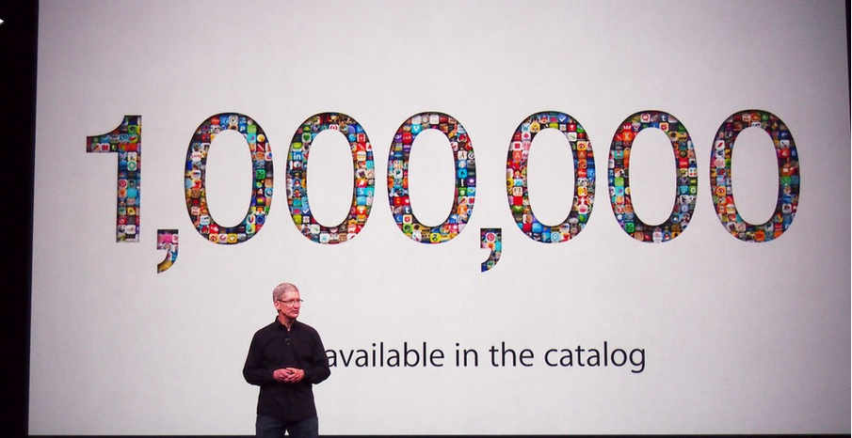
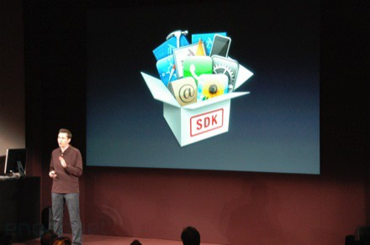
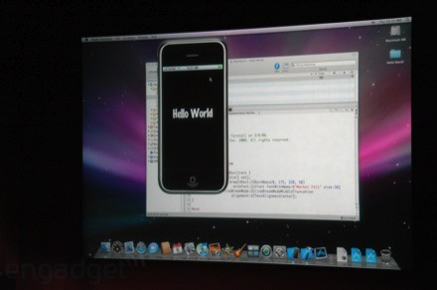
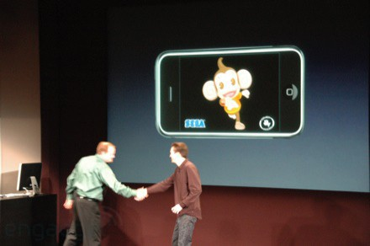
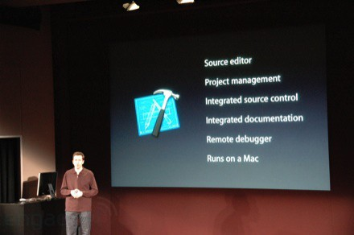
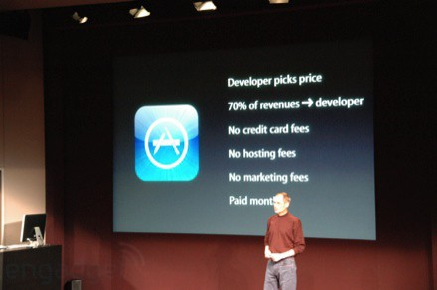

March 6, 2008 iPhone SDK Press Conference

Slide 37
Building Educational Apps with Tsugi / Django
from django.shortcuts import render
from django.views import View
from django_tsugi.mixins import TsugiMixin
class GradeView(TsugiMixin, View):
def get(self, request) :
context = {'tsugi': request.tsugi}
return render(request, 'grade/main.html', context)
def post(self, request) :
grade = float(request.POST.get('grade'))
comment = request.POST.get('comment')
retval = request.tsugi.result.gradeSend(grade, comment)
context = {'tsugi': request.tsugi, 'retval' : retval}
return render(request, 'grade/done.html', context)

Slide 38

Any Questions? www.sakailms.org www.tsugi.org www.py4e.com www.wa4e.com www.dj4e.com

